Slide 1

OLIST Retail Dashboard
BALC Project Competition 2.0
Mentor: Preksha Shah
Mentees:
Laura Chow
Meng Hsuan Tsai
Olivia Aneye
Sumit Sapra
Suyash

Slide 2

Purpose
Build a retail dashboard for the industry for promotional optimization using Tableau and making recommendations using analysis for making better and faster decisions.

Slide 3

Dataset
Available on Kaggle: Brazilian E-Commerce Public Dataset by OLIST Ref.
E-Commerce data for Orders, Sellers, Customers, Products
8 tables - Merged on foreign keys

Slide 4
Exploratory Data Analysis (EDA)
Tables divided into 5 parts
Each person worked separately on EDA in Python/R
Brainstormed analysis and understood data before moving to Tableau

Slide 5

Dashboards

Slide 6
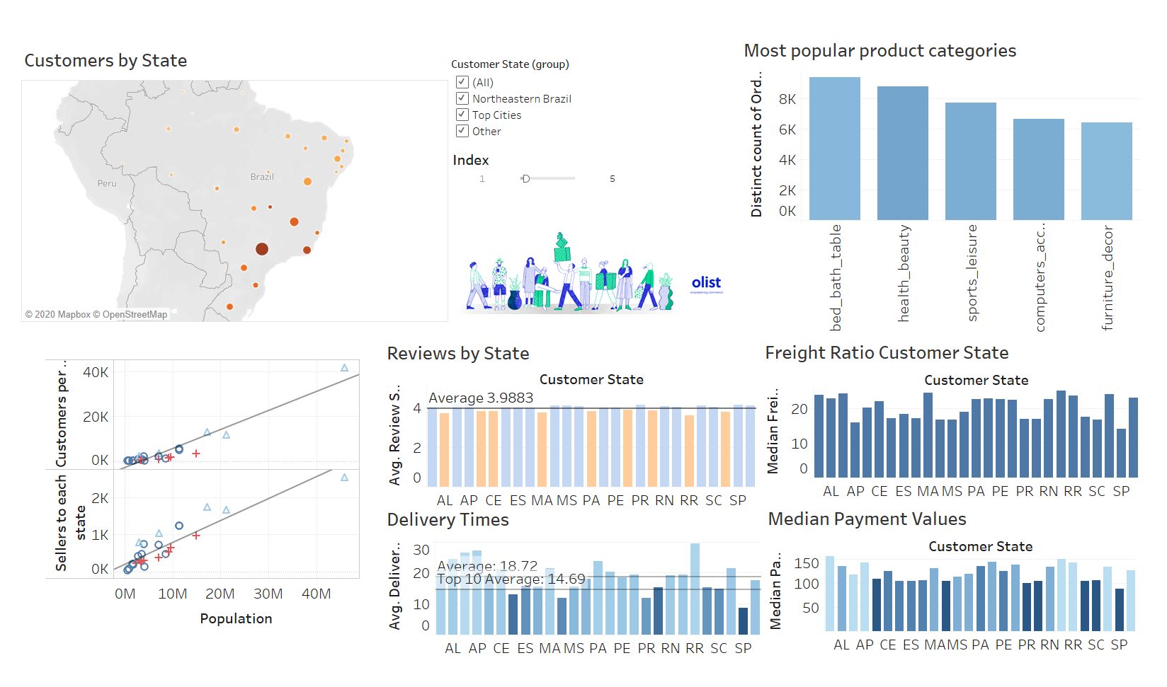

Slide 7
Customer Recommendations
Focus on the northeastern part of Brazil. Why?
Room for growth
Recommendations
Increase sellers in northeastern region
Sell cheap items in health and beauty, sports and leisure, and electronic accessories categories

Slide 8
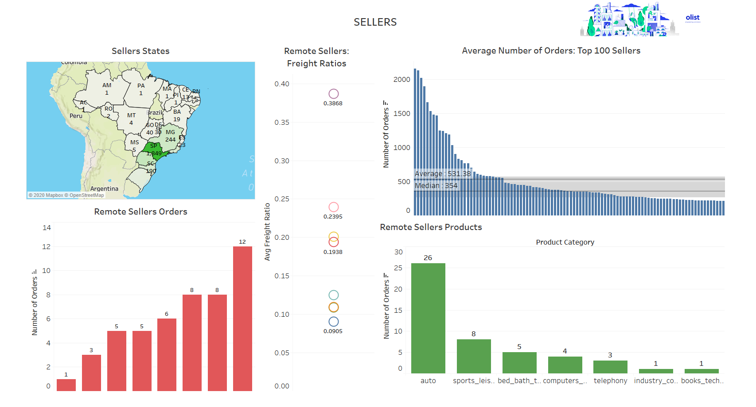

Slide 9
Sellers Recommendations
Remote areas with less sellers
Low population density, less wealthy regions
Probably less access to internet
What should OLIST do?
focus on items not available in local stores in these areas

Slide 10
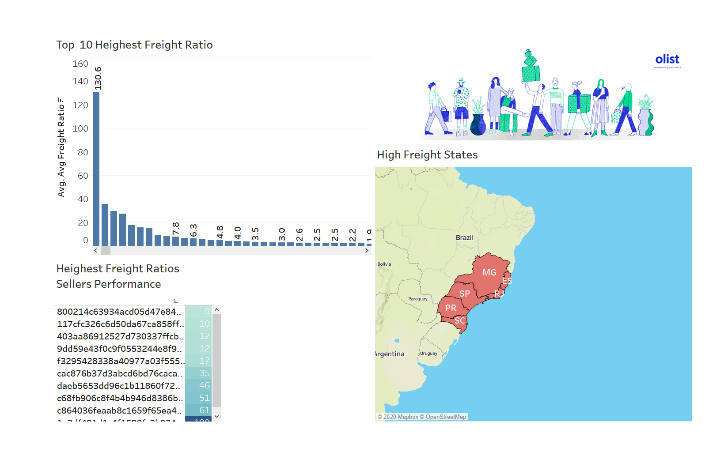

Slide 11

Freight Recommendations
High freight ratios: potential deterrent for customers
What should Olist do?
Install pick-up points for orders:
customers can pick up orders at their convenience
convenient pickup time windows (after work hours etc...)
will eliminate high freight and long delivery times issue

Slide 12
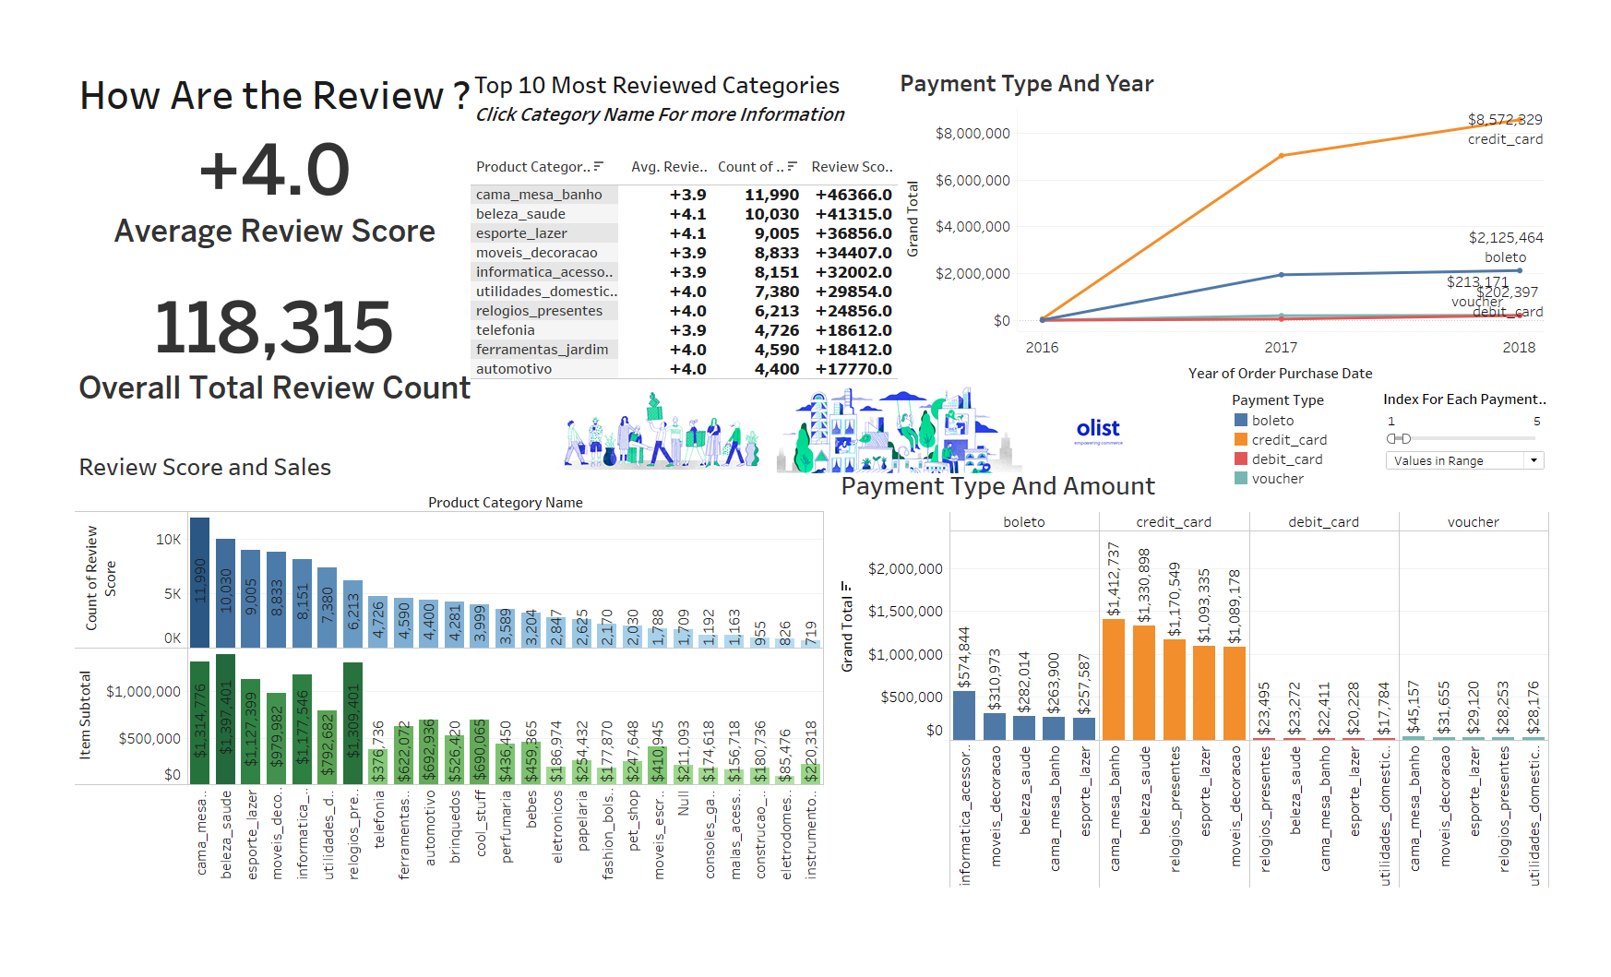

Slide 13


Review and Payment Type Recommendations
Based on Review Score, Olist can launch seller improvement program to improve Customer Service
Based on the Credit Card usage and growth, Olist can launch their own credit card

Slide 14

Thank you !

